Slide 1
Configuration Guide
(Web Server – WebtoB 4.1
for codelabor-spring-mvc-template-static)
2009. 09. 23
CODELABOR
Shin Sang Jae (codelabor@gmail.com)

Slide 2
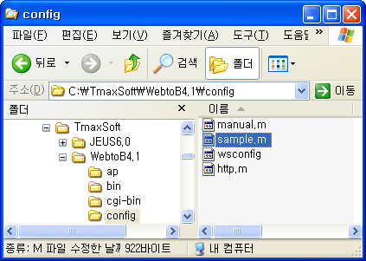
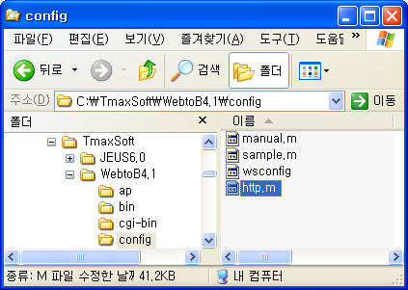
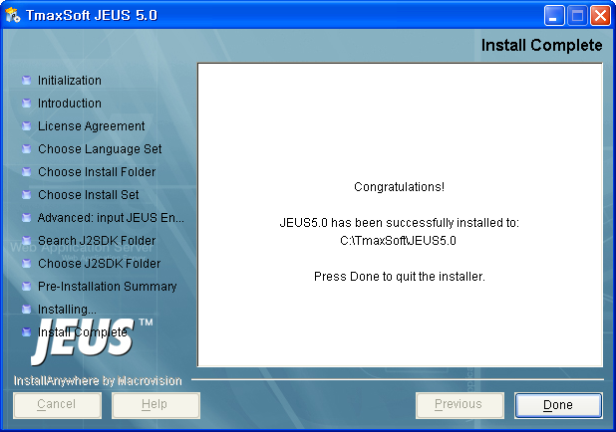
WebtoB
Configuration
Config Directory: C:\TmaxSoft\WebtoB4.1\config
Copy Config File:
  sample.m > http.m

Slide 3
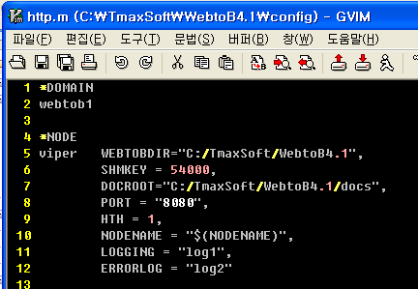
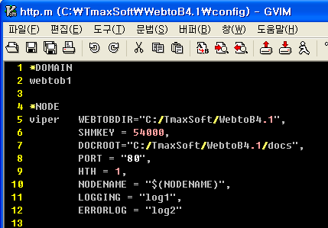
WebtoB
Configuration
Edit http.m
Change Port
  Port: 8080 > 80

Slide 4
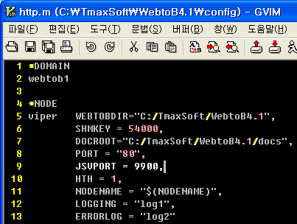
WebtoB
Configuration
Edit http.m
Add JSVPORT
  Node JSV Port: 9900

Slide 5
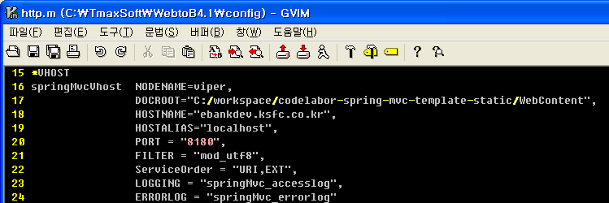
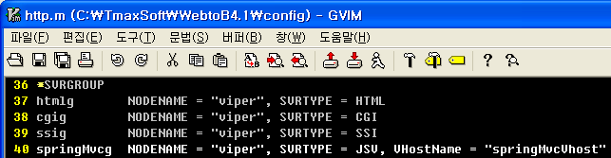
WebtoB
Configuration
Add VHOST
Add SVRGROUP

Slide 6
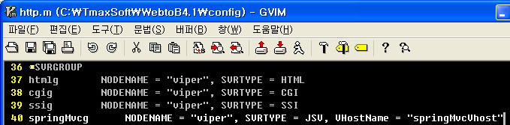
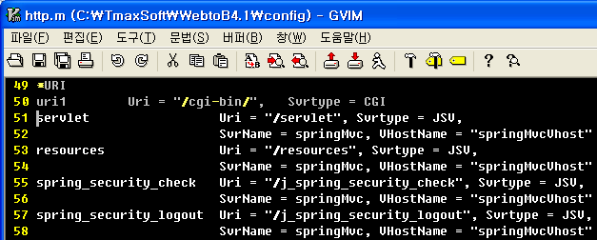
WebtoB
Configuration
Add SERVER
Add URI

Slide 7
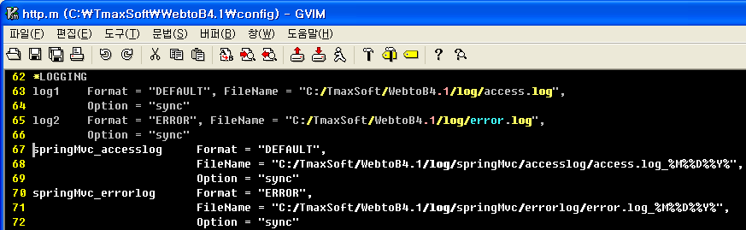
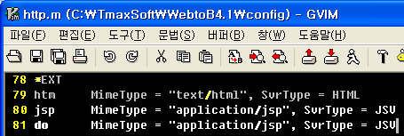
WebtoB
Configuration
Add LOGGING
Add EXT

Slide 8
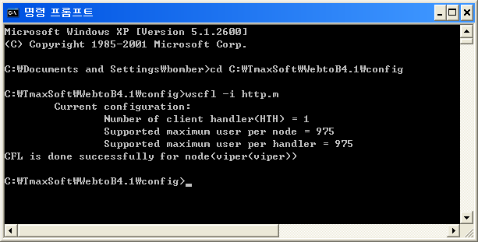
WebtoB
Compile Configuration
Move Config Directory
Config Directory: C:\TmaxSoft\WebtoB4.1\config
Command: wscfl –i http.m

Slide 9
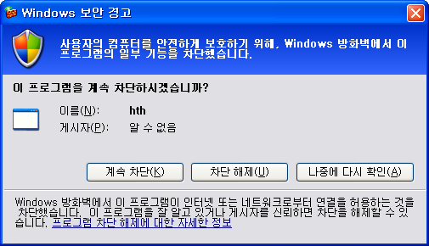
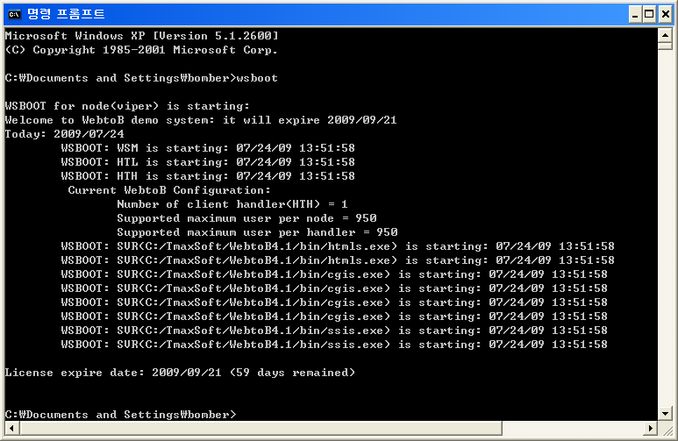

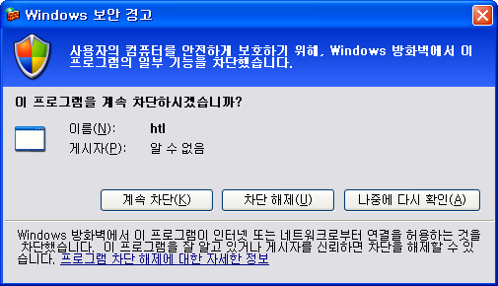
WebtoB
Compile Configuration
Run WebtoB
Command: wsboot
Allow Firewall

Slide 10
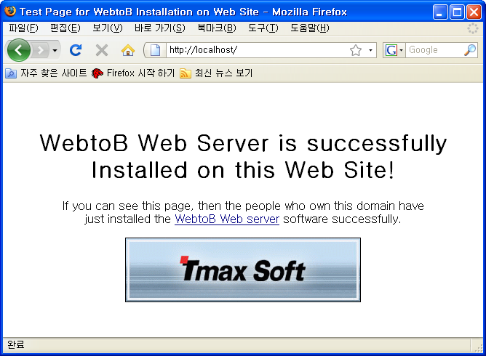
WebtoB
Browse Page
Browse Site
URL: http://localhost/

Slide 11
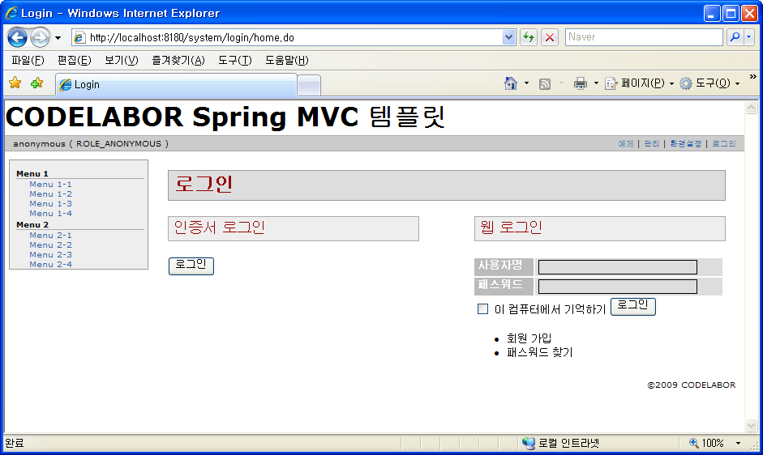
WebtoB
Browse Page
Browse Site
URL: http://localhost:8180/

